Slide 1
Floyd–Warshall's Algorithm
Floyd–Warshall's Algorithm is used for finding shortest path between all pairs of nodes in an weighted graph. We run this algorithm on adjacency matrix of a graph.
Time Complexity O(nodes^3)
Space Complexity O(nodes^2)
Visualization: Floyd-Warshall All-Pairs Shortest Path

Slide 2
mtx[u][v]=infinity if there is no edge between u an v
mtx[u][v]=0 if u==v
mtx[u][v]= weight of edge between u and v
for(k=1;k<=n;k++){//this node selection must be in outer loop
for(i=1;i<=n;i++){
for(j=1;j<=n;j++){
if(mtx[i][j]>mtx[i][k]+mtx[k][j]){
mtx[i][j]=mtx[i][k]+mtx[k][j];
//if current path from i to j is more costly
//than cost path i to k and path k to j
//than we will use path i->k->j
}
}
}
}

Slide 3
Think why this implementation of warshall’s algorithm will not work:
for(i=1;i<=n;i++){
for(j=1;j<=n;j++){
for(k=1;k<=n;k++){
if(mtx[i][j]>mtx[i][k]+mtx[k][j]){
mtx[i][j]=mtx[i][k]+mtx[k][j];
}
}
}
}

Slide 4
Consider this Graph:
1
2
4
3
2
3
1
If we run the loop in i->j->k order then the path 1->2 will never be updated

Slide 5
How this works:
When k=1, it updates between all i,j which contains may 1 is as intermediate node. Max length of path 3[i->1->j]
When k=2, it updates between all i,j which contains may {1,2} is as intermediate node. Max length of path 4[i->1->2->j or i->2->1->j]
When k=3, it updates between all i,j which contains may {1,2,3} is as intermediate node. Max length of path 5[i->x->y->z->j ]
And so on

Slide 6
Dijkstra algorithm
Dijkstra's algorithm finds the shortest paths from one source node to all other nodes in the graph. It's similar to bfs. But the main difference is it works in weighted graphs.
Time complexity:
O(N+E*log(N)) with priority queue
O(N*N) without priority queue

Slide 7
Algorithm Steps:
Set the source node distance = 0 and all nodes distances = infinity
Push the source node in priority queue
Pop the vertex with the minimum distance from the priority queue.
Let the popped node u and all connected nodes to it v .
for all v
if(distance of v> distance u+edge cost of u to v)
update distance[v]=distance u+edge cost of u to v;
push v to the queue with new distance
goto step 3 unless the queue is empty.

Slide 8
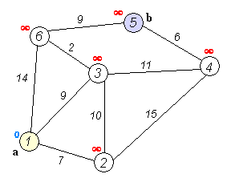
Visualization:
*Collected from Wikipedia

Slide 9
Disjoint Set (Union Find)
It’s a data structure which is used to track if two nodes in a graph are in same component or not. We can easily do it with BFS/DFS but Disjoint Set works much faster and easy to code.
**In this topic I am using pictures from a blog: shafaetsplanet.com

Slide 10
This graph contains two components. In this algorithm we will consider a node as representative of all nodes of a component.

Slide 11
In first step we consider each node as a separate component. Each node will be its own representative. Then we will connect nodes one by one and change representative.
Here:
rep[a]=a
rep[b]=b
rep[c]=c
rep[d]=d
rep[e]=e

Slide 12
Now we will bring the edge between a and b. Node a and b will be in same component.
So representative of a will be b.
rep[a]=rep[b]=b;

Slide 13
Then we will bring edge between b and c.
Thus:
rep[c]=rep[b]=b

Slide 14
We also connect node d and e.
rep[e]=d

Slide 15
Finding Representative:
find(int x){
if(x==rep[x])return x;
return find(rep[x]);
}
union(int a,int b){
int c,d;
c=find(a);
d=find(b);
rep[c]=d;
}

Slide 16
Now let’s connect b and d. And some more nodes.

Slide 18
find(int x){
if(x==rep[x])return x;
return find(rep[x]);
}

Slide 19
int find(int x){
if(x==rep[x]) return x;
return rep[x]=find(rep[x]);
///Here we are storing the result
}

Slide 20
Minimum spanning tree (Kruskal's algorithm)
Minimum spanning tree(MST) is it the optimal tree made from a connected graph taking a subset edges where the sum of tree edge weight is minimum. We will use disjoint set data structure for implementing this algorithm.
**I will use pictures from wikipedia in this topic.

Slide 21
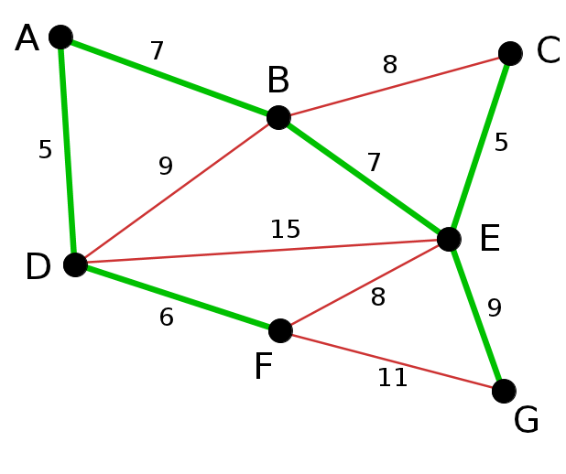

Slide 22
Steps of algorithm:
Sort the edges of graph according to their weight.
Pick next edge whose two nodes are not in same component. Bring that in tree.
Continue this until all nodes are in same component.

Slide 23
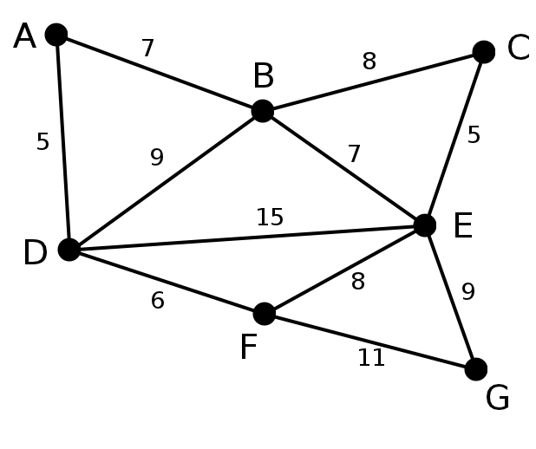

Slide 24
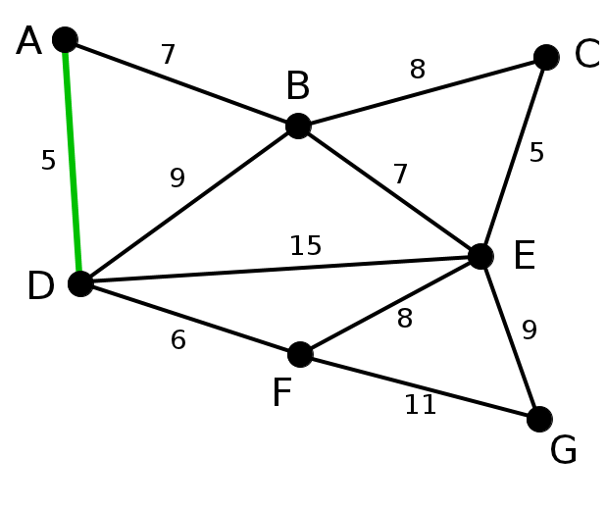
Here A-D and C-E edge have lowest weight(5). We take A-D edge in subgraph

Slide 25
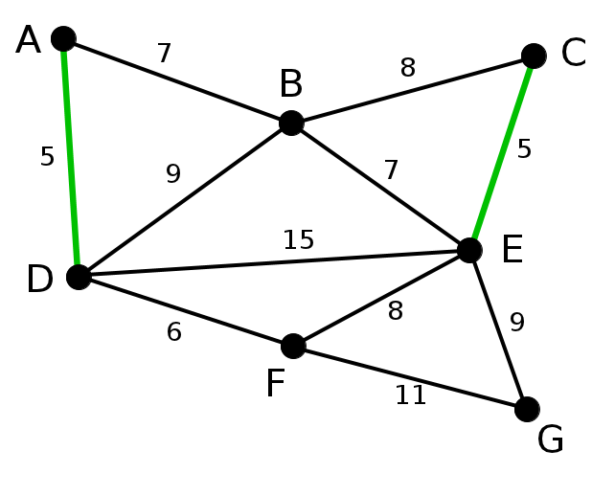
We will also take C-E edge as node C and E are not in same component.

Slide 26
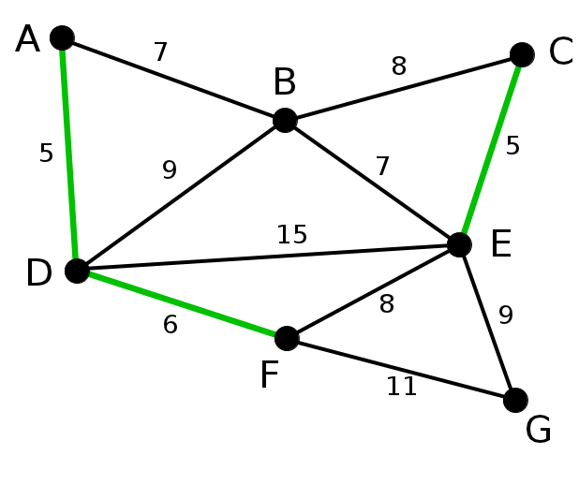
Next we will take E-F edge in subgraph as node D and F are not in same component.

Slide 27
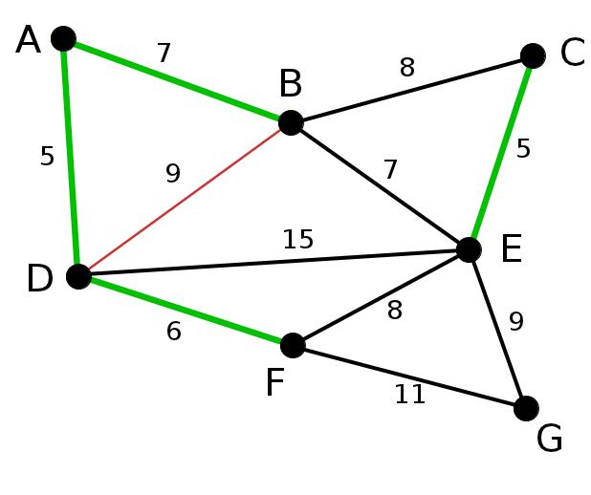
Next we will take A-B edge in subgraph as node A and B are not in same component.

Slide 28
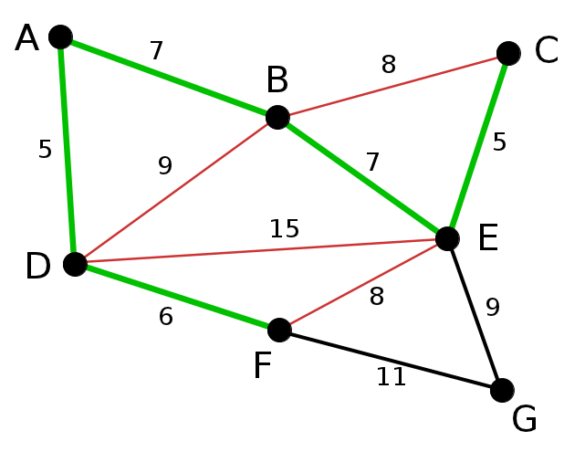
Next we will take B-E edge in subgraph as node B and E are not in same component.

Slide 29
Now next edge is F-E. But nodes F and E already in same component.
So we will skip edge F-E

Slide 30
Next we will take E-G edge in subgraph as node E and G are not in same component.
We have already taken n-1 edges. We got the MST

Slide 31
Minimum spanning tree (Prim's Algorithm)
This Algorithm works in a similar way to Dijkstra.
Time Complexity: O(Elog(E)) or O(Elog(N))
Steps:
First pick a node and push it’s connected edge to a queue.
Then we take/pop the edge with lowest cost from the queue.
With that edge we visit a node(If they are new) and again push it’s connected edges to the queue.
Continue this until all all nodes are visited.
*Images in this topics are from: hackerearth.com

Slide 32
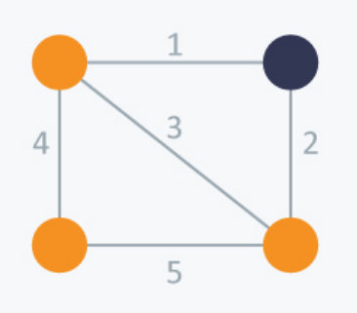
A node pick. Two edge{1,2} are pushed to queue.

Slide 33
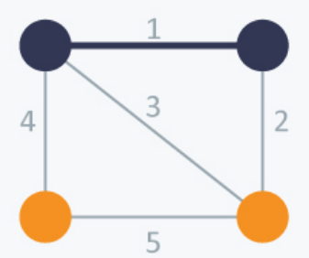
New node visited. 2 new edges{4,3} are pushed to queue.

Slide 34
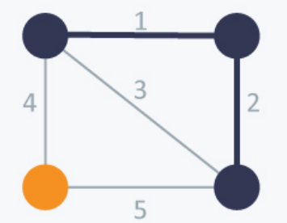
Next low cost edge with weight 2. New node visited.
1 new edges are pushed to queue.
Next node with cost 3. We have to skip this

Slide 35
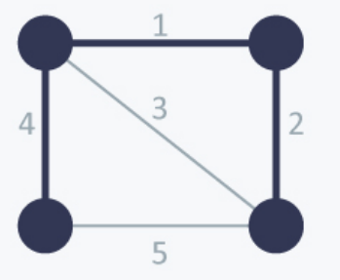
Last node with edge cost 4 visited.

